Slide 1

SAP Build Training for Corporate Professionals
DAY-19
www.anubhavtrainings.com

Slide 2


DISCLAIMER
The training content and delivery of this presentation is confidential, and cannot be recorded, or copied and distributed to any third party, without the written consent of Anubhav Trainings

Slide 3
Agenda
SAP Build Transport
SAP CI CD Service
TMS Service
Content Transport

Slide 4
Build Transport
A transport mechanism enables developers to transfer processed data between different tenants such as dev, test, and prod in a more controlled and seamless way. The new transport process setup is described in detail on the help page and takes advantage of two utility services on SAP BTP, namely SAP Cloud Transport Management and SAP Content Agent Service.
https://help.sap.com/docs/cloud-transport-management/sap-cloud-transport-management/initial-setup
https://help.sap.com/docs/CONTENT_AGENT_SERVICE/ae1a4f2d150d468d9ff56e13f9898e07/15406a06dfac4c1fabd7845c703773ba.html
https://help.sap.com/docs/CONTENT_AGENT_SERVICE/ae1a4f2d150d468d9ff56e13f9898e07/eed66f35f9d148c8ae5b2d46ff097d8c.html
The transport process functionality allows to seamlessly move applications and other processed data from one tenant to another, which is a crucial step in the development lifecycle. This is particularly important when working on complex enterprise applications that need to be tested thoroughly before being released into production. The new transport process setup provides developers with more control over their processes and ensures that any changes made to applications are thoroughly tested and vetted before being released into the production environment.

Slide 5
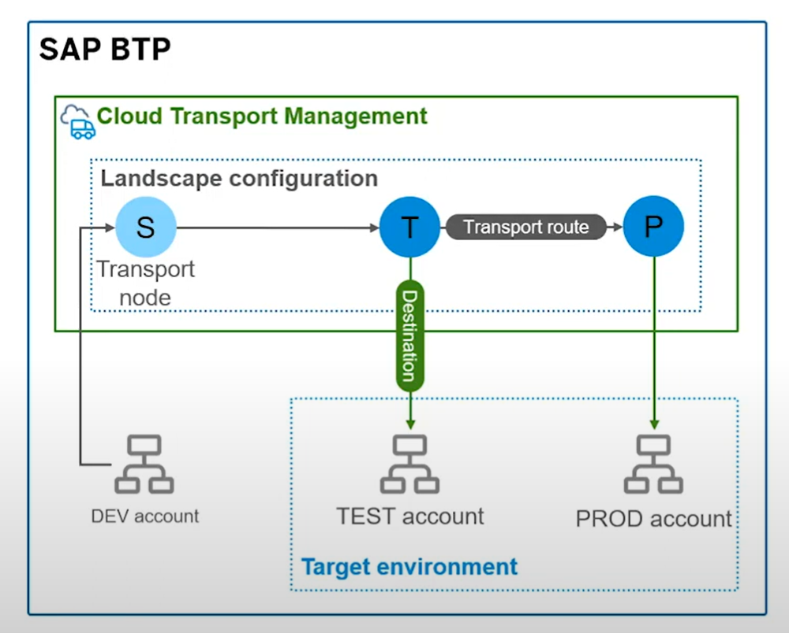
Cloud Transport Management Service
<content>
SAP Cloud Transport Management service lets you manage software deliverables between accounts of different environments, by transporting them across various runtimes. This includes application artifacts as well as their respective application-specific content.

Slide 6
Setting up CTMS
It's worth noting that the CTMS (Cloud Transport Management System) tenant needs to be set up in advance before you can use the new transport process functionality in SAP BTP BUILD platform. This tenant is responsible for managing the transport process between the source and target tenants and requires specific configuration.
Best practice is to set up the CTMS on a special subaccount for single tenant applications/services. For more information on setting up the CTMS, please refer to the SAP Help page on this link:
https://help.sap.com/docs/TRANSPORT_MANAGEMENT_SERVICE/7f7160ec0d8546c6b3eab72fb5ad6fd8/66fd7283c62f48adb23c56fb48c84a60.html.

Slide 7
Steps
Create a subscription (lite) for Cloud Transport Management and assign role to our user for TMS
Create a instance for Cloud Transport management
Create a service key for the instance created in step 2
Create spaces for quality as qlt and production as prod
Go inside each space, and note down the space id
Qlt - eeb23cb1-5693-4ec5-ab8f-369ddd2b5d83
Prod - 98a68cb3-1f15-4c58-962c-d88b8f66f67e
https://deploy-service.cf.<domain>/slprot/<my-space-guid>/slp
https://deploy-service.cf. us10-001.hana.ondemand.com/slprot/eeb23cb1-5693-4ec5-ab8f-369ddd2b5d83/slp
https://deploy-service.cf. us10-001.hana.ondemand.com/slprot/98a68cb3-1f15-4c58-962c-d88b8f66f67e/slp
6. Create destination according to the documentation here
7. Launch the Cloud transport cockpit and configure our landscape and route
Phase 2
Create subscription for content agent service and assign role to our user
Create instance for content agent service and create a service key

Slide 8
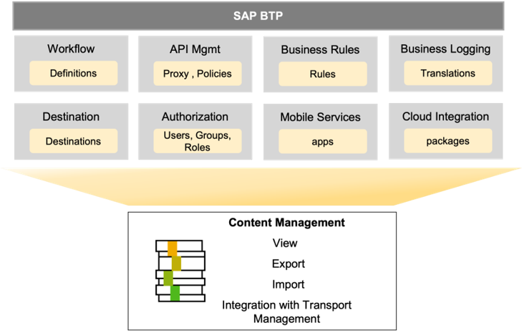
What is CMS (Content Management Service)
A tool that acts as a local agent and operates at sub account level for managing content operations for different SAP BTP services. This service is offered in overall contract with SAP BTP and is auto-entitled.

Slide 9
Setting up CAS
In addition to the SAP BTP BUILD platform, the source tenant also requires an instance of the Content Agent Service (CAS) to work with the CTMS.
The CAS serves as a link between BUILD content and the CTMS, providing the necessary functionality to export and import the content from and to the CTMS.
To set up the CAS in the source tenant, you'll need to create an instance of the Content Agent Service in the subaccount.
You can find detailed information on how to create an instance of the Content Agent Service in the SAP Help page on this link:
https://help.sap.com/docs/CONTENT_AGENT_SERVICE/ae1a4f2d150d468d9ff56e13f9898e07/15406a06dfac4c1fabd7845c703773ba.html.

Slide 10
Create destination to TMS
Once you have created the CAS instance, you'll need to create a new destination with the name "TransportManagementService".
This destination serves as a connection to the CTMS instance. You can create this destination in the SAP BTP Cockpit by navigating to your subaccount and selecting "Destinations" from the left-hand menu. Detailed info can be found here:
https://help.sap.com/docs/CONTENT_AGENT_SERVICE/ae1a4f2d150d468d9ff56e13f9898e07/eed66f35f9d148c8ae5b2d46ff097d8c.html

Slide 11
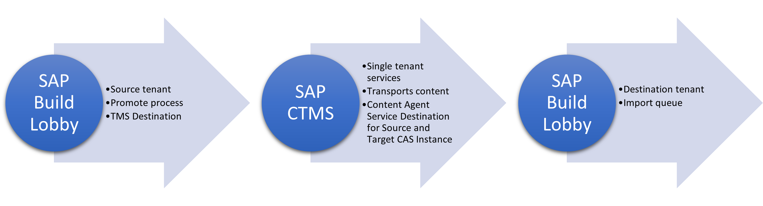
The Process
https://help.sap.com/docs/content-agent-service/user-guide/create-target-node-destination

Slide 12
<content>

Slide 13

What We Did
Let’s Summarize
www.anubhavtrainings.com

Slide 14
www.anubhavtrainings.com
Thank You
End of Day 19
www.anubhavtrainings.com

Slide 15



We’re committed to empower you to be
#FutureReady
through powerful training solutions.
We build the workforce of the future.
250+
Corporate Clients
30,000+
Learners Trained
25000+
Learners Placed
FREE WEBINARS
Sign up for free webinars with industry experts every fortnight!
Enroll Now!
Contact us today!
https://anubhavtrainings.com

